Slide 1


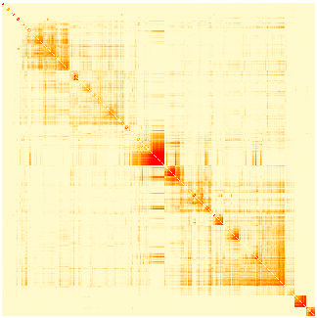
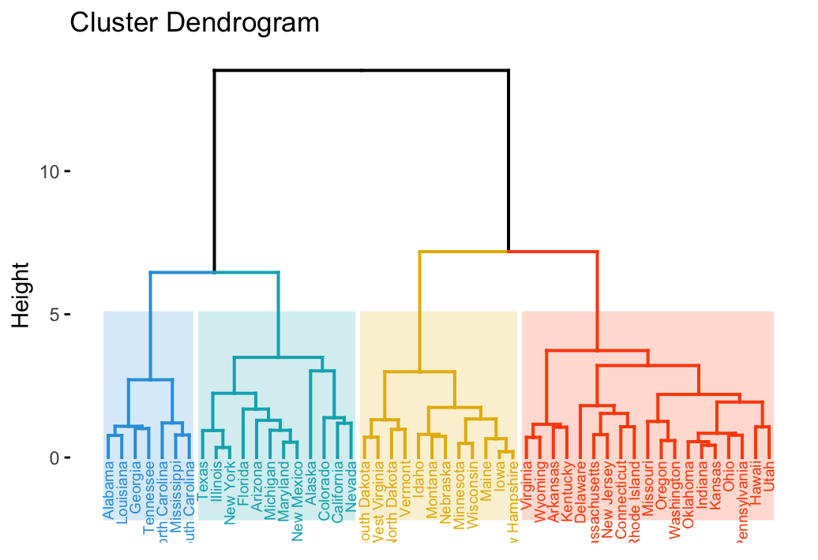
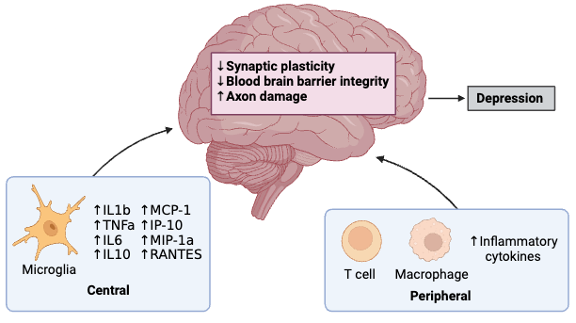
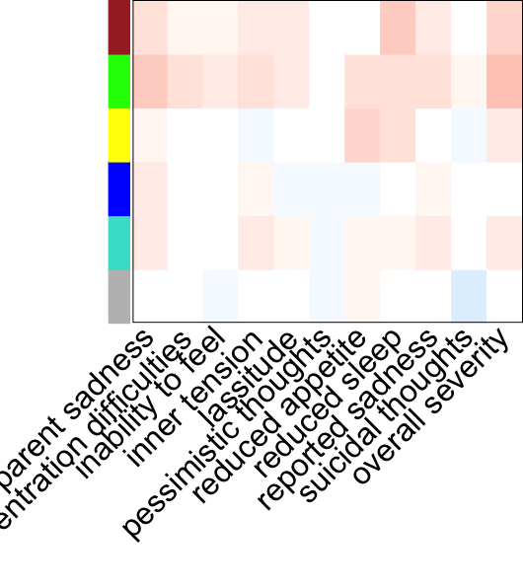




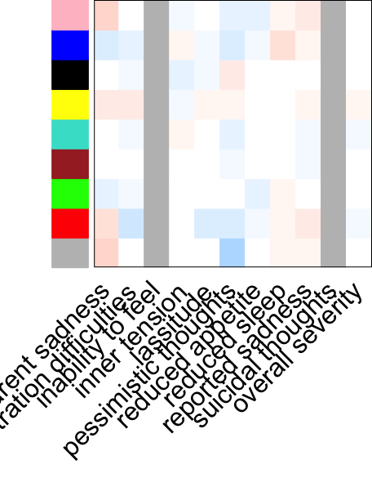

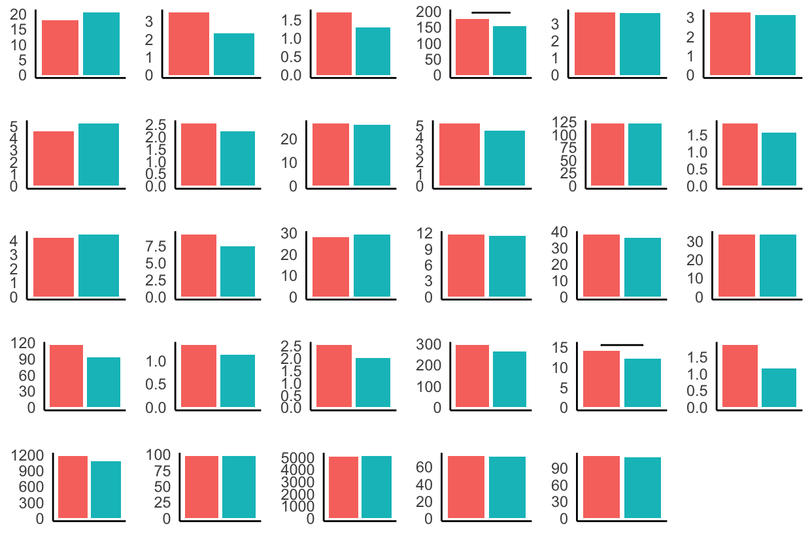
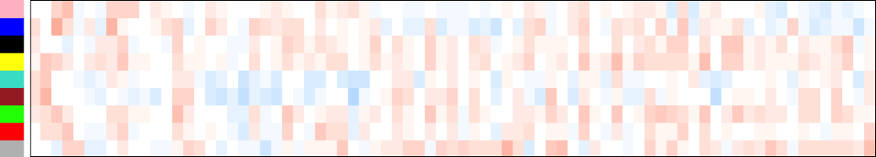
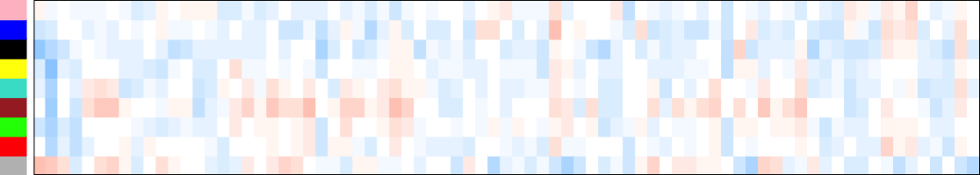
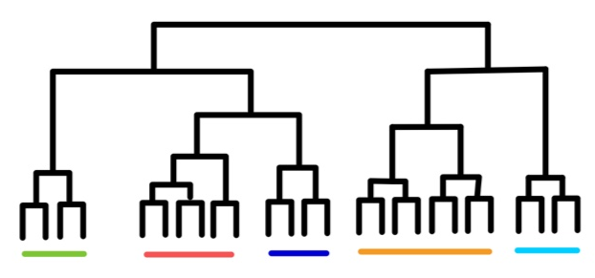
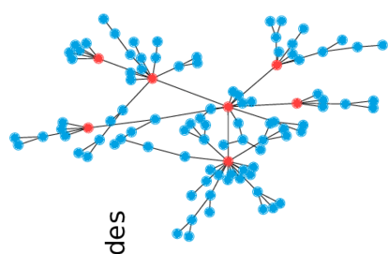
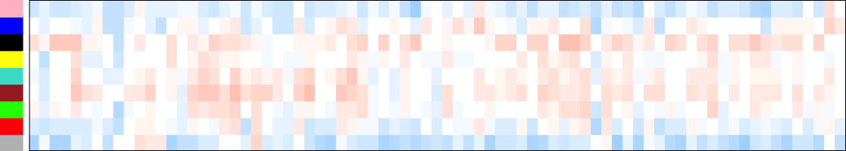





Multivariate Analysis Using Co-Expression Network Modeling Identifies Specific
Inflammation and Diffusion MRI Features
in Major Depressive Disorder
Lucy Hui, Joanna Chen, Jean Chen
Rotman Research Institute, Baycrest Health Sciences, Toronto, Canada
BACKGROUND
PIPELINE
Major depressive disorder (MDD)
MDD is the most prevalent psychiatric condition marked by persistent sadness and cognitive impairments.
Only 50% of the MDD population respond to treatments derived from the monoamine hypothesis, implicating alternative pathophysiological underpinnings.
Recent research indicates that neuroinflammatory processes play a significant role in its development. Crucially, there are notable sex differences in both the presentation and underlying neuroinflammatory mechanisms.
Canadian Biomarker Integration Network in Depression (CANBIND-1)
Weighted Gene Co-expression Network Analysis (WGCNA)
Baseline
MDD (n = 211)
Control (n = 122)
Coexpression network
Identify modules
Relate to external traits
132 Female
74 Male
65 Female
38 Male
Participants
Modalities
Molecular
Clinical
Imaging
Participants
Genetic Modules
29 cytokines & chemokines
11 depression subcomponents
4 diffusion MRI parameters
Inflammatory markers
Depression components
MRI measures
RESULTS
MDD
Turquoise: IL2, IL5, IL6, IL8, IL12, G-CSF, MIP-1a, VEGF
Yellow: IL4, Eotaxin, IL7
Brown: IL9, MIP-1b, RANTES, TNFa
Blue: IL1b, IL10, IL13, GM-CSF
Green: IL17, FGF, PDGF
Grey: IFABP, CRP, IL1ra, IL15, IFN, IP10, MCP
Control
Pink: IL1b, IL13
Red: IL1ra, G-CSF, MIP-1a
Green: IL2, IL7, IL8, IL17
Blue: IL4, Eotaxin, IL10, MCP
Brown: IL5, IL12, GM-CSF, IFN
Turquoise: IL6, IL15, IP10, VEGF
Yellow: IL9, MIP-1b, RANTES, TNFa
Black: FGF, PDGF
Grey: IFABP, CRP
a)
b)
CDI
FWF
MDD
MDD
FAt
Figure 1. Mechanisms of Neuroinflammation [1]
MDt
Weighted Gene Co-expression Network Analysis (WGCNA)
Bioinformatics tool used to identify modules or clusters of highly correlated genes across different biological conditions.
Constructs a network where nodes represent genes and edges represent pairwise correlations between gene expression profiles.
Unveils biological processes by associating modules with phenotypic traits, clinical outcomes, or experimental conditions.
Figure 3. Inflammatory modules detected by WGCNA in MDD and control subjects.
IFBAP
CRP
IL1b
IL1ra
IL2
IL4
CDI
IL5
IL6
IL7
IL8
IL9
IL10
FWF
Control
Control
FAt
IL12
IL13
IL15
IL17
Eotaxin
FGF
MDt
G-CSF
GM-CSF
IFN
IP10
MCP1
MIP1a
CDI: Correlation diffusion index
FWF: Free water fraction
FAt: Free water corrected fractional anisotropy
MDt: free water corrected mean diffusivity
Anhedonia
Inner tension
Lassitude
Figure 2. Hierarchical clustering for scale free networks [2-3]
Pessimism
Reduced appetite
Reduced sleep
Reported sadness
Suicidal thoughts
Apparent sadness
Overall severity
OBJECTIVES
PDGF
MIP1b
RANTES
TNFa
VEGF
IL4
Reduced focus
Identify sex-dependent modules of co-expressed genes associated with inflammatory biomarkers in MDD patients and healthy controls, elucidating shared and distinct networks underlying inflammation in depression.
Assess the correlation between inflammatory gene expression modules, clinical variables, and neuroimaging markers to elucidate the clinical relevance of immune dysregulation in MDD.
MDD
Control
Figure 4. Average inflammatory marker levels (mg/L) in MDD and control subjects. Horizontal bar depicts p<0.05.
Montgomery–Åsberg Depression Rating Scale
Diffusion MRI-based Brain Parcellation
Figure 5. Module-Trait correlations for depression (a) and MRI (b). Red: r²>0. White: r²=0. Blue: r²<0. Grey: missing values.
DISCUSSION
ACKNOWLEDGEMENTS
REFERENCES
WGCNA-derived brown and green inflammatory modules revealed positive correlations with the traits of depression, fractional anisotropy, and mean diffusivity in MDD.
The simultaneous reduction of fractional anisotropy with mean diffusivity in MDD suggests the presence of cytotoxic edema and neurodegeneration.
Moreover, MDD inflammatory modules are negatively correlated with correlation diffusion index in white matter tracts, implying decreased white matter integrity.
This project is supported by the Data Sciences Institute, University of Toronto
Miller, A., Raison, C. The role of inflammation in depression: from evolutionary imperative to modern treatment target. Nat Rev Immunol 16, 22–34 (2016). https://doi.org/10.1038/nri.2015.5
Kim, C. How to find the optimal number of clusters with R? Medium (2022). https://medium.com/@chyun55555/how-to-find-the-optimal-number-of-clusters-with-r-dbf84988388b
Wurzburg, J. Synchrony Measurement and Connectivity Estimation of Parallel Spike Trains from in vitro Neuronal Networks (2020). DOI:10.25972/OPUS-22364.
lucy-mhui

Slide 2

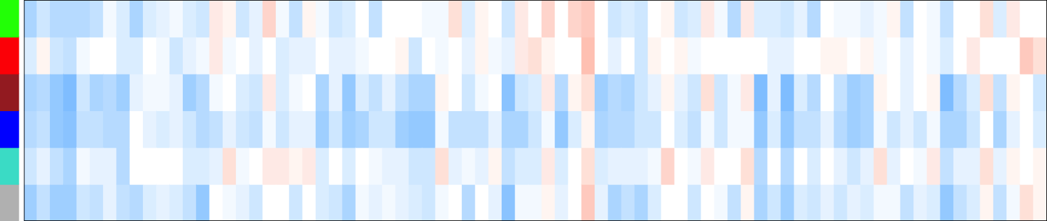
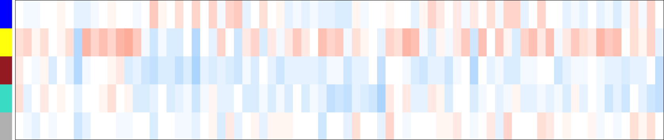
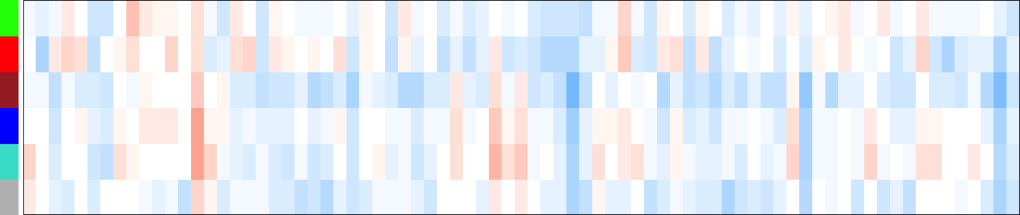
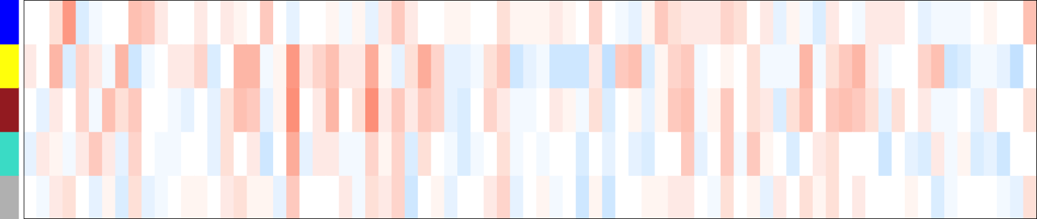
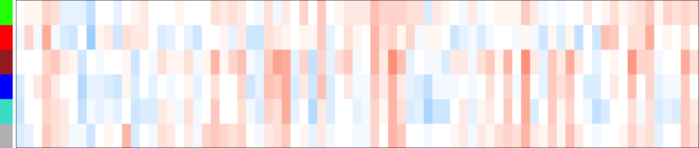
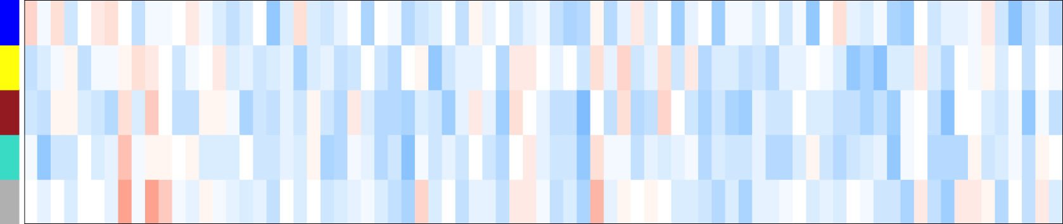

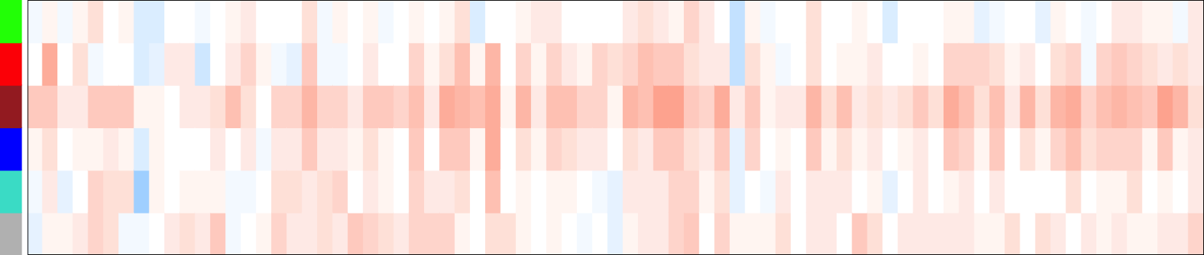
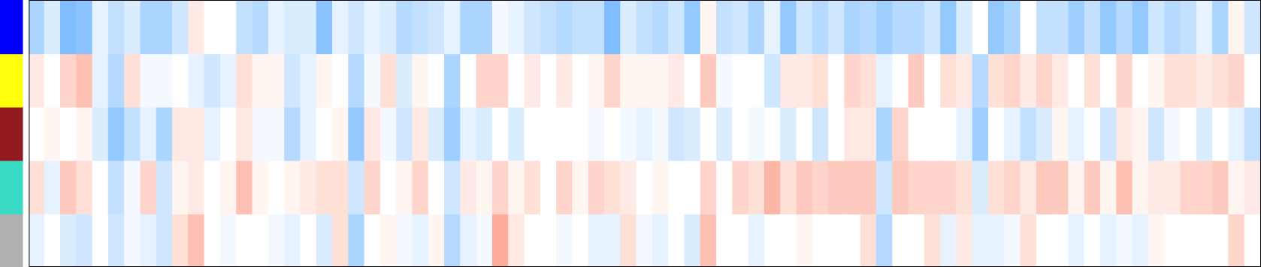
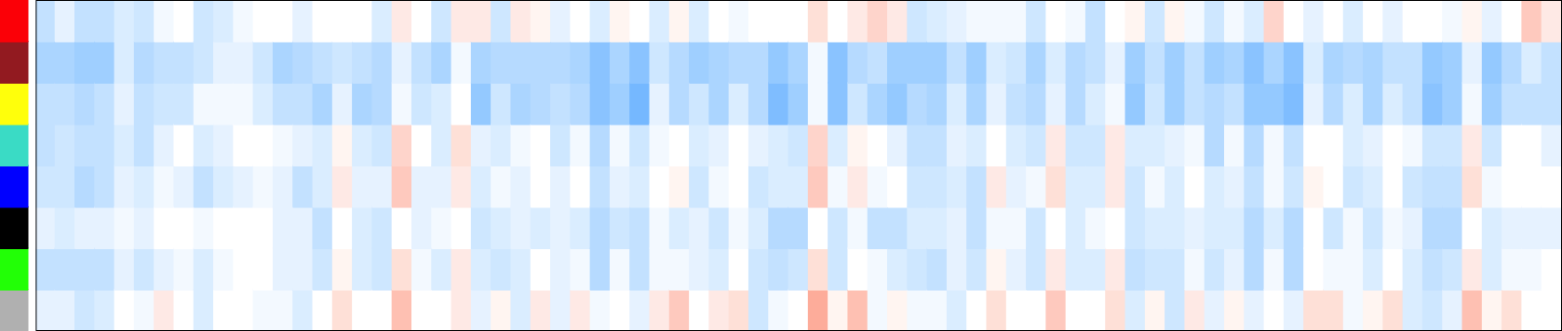
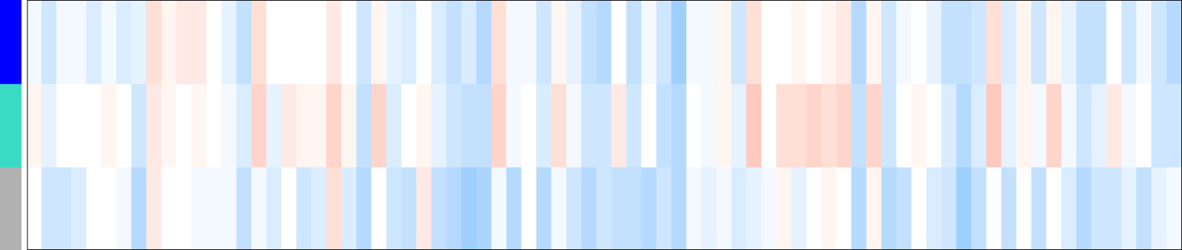
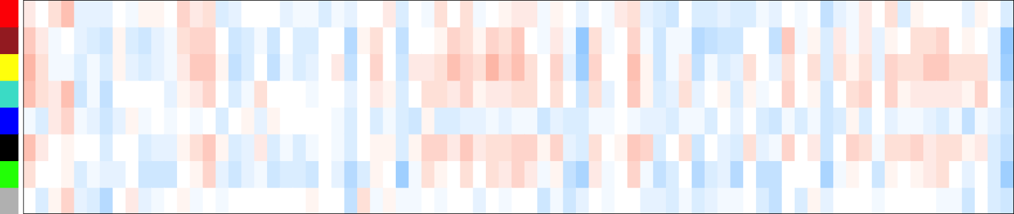
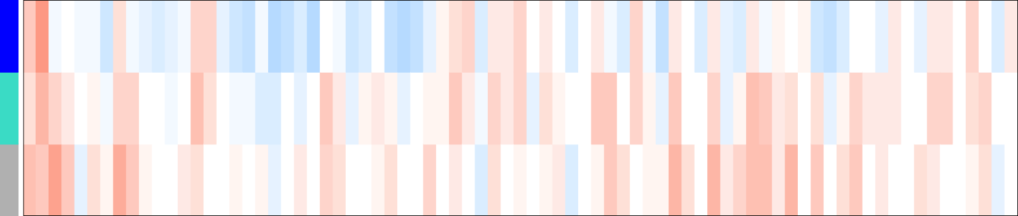
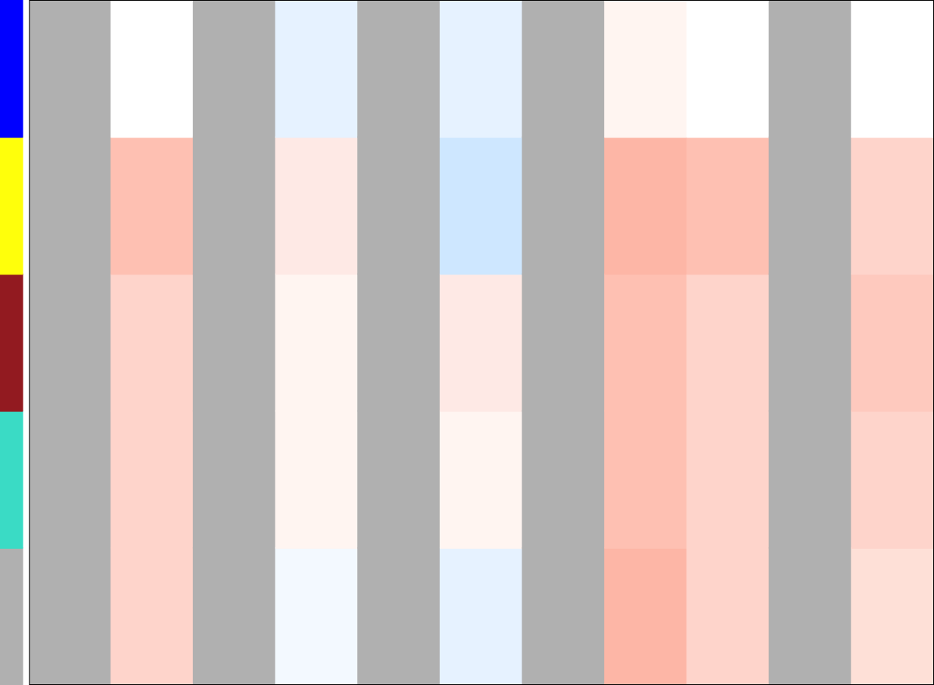
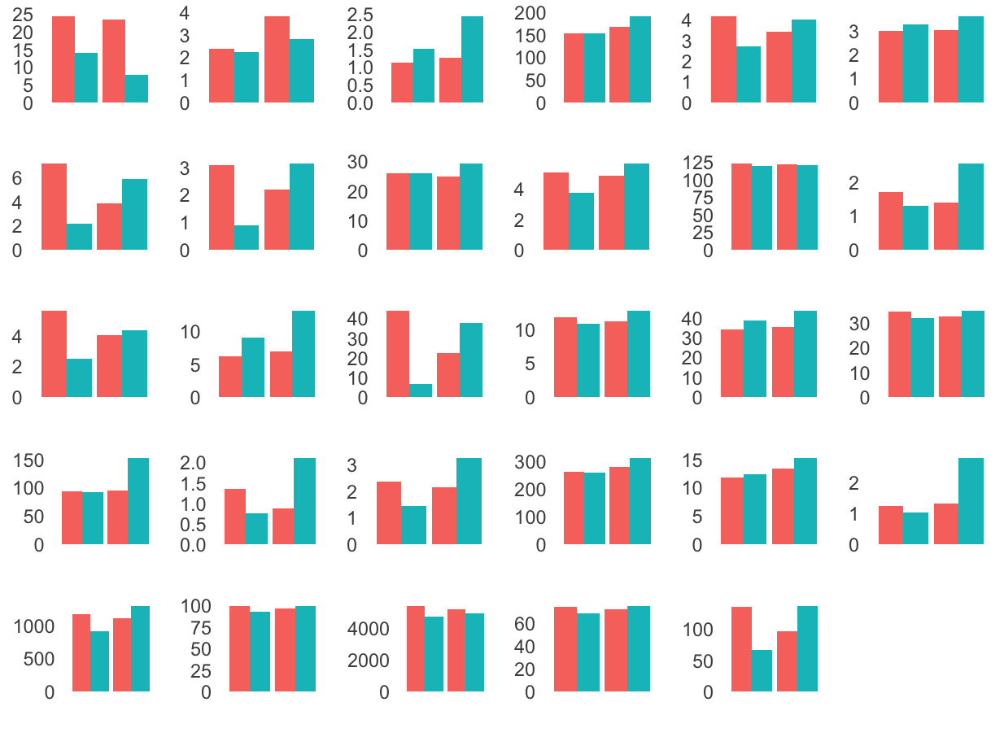
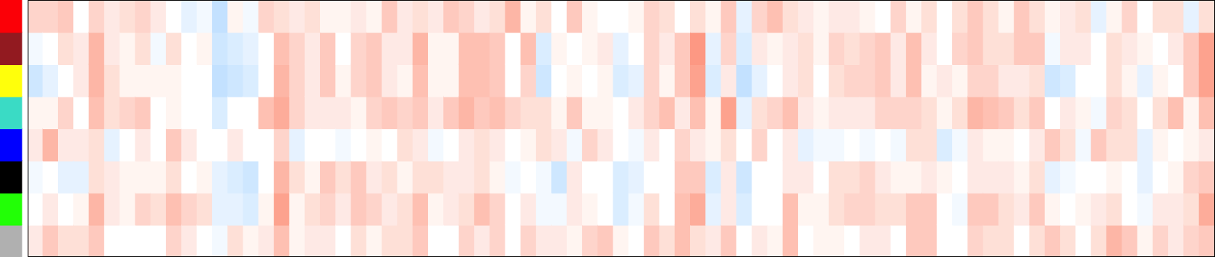
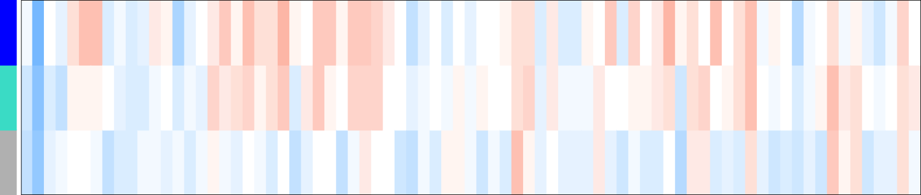
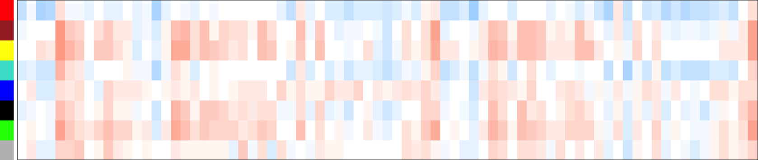
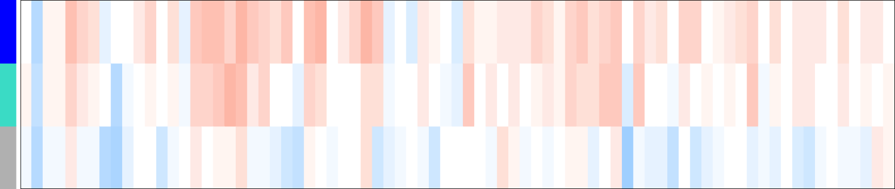

Multivariate Analysis Using Co-Expression Network Modeling Identifies
Sex-Specific Inflammation and Diffusion MRI Features
in Major Depressive Disorder
Lucy Hui, Joanna Chen, Jean Chen
Rotman Research Institute, Baycrest Health Sciences, Toronto, Canada
OBJECTIVES
PIPELINE
Identify sex-dependent modules of co-expressed genes associated with inflammatory biomarkers in MDD patients and healthy controls, elucidating shared and distinct networks underlying inflammation in depression.
Assess the correlation between inflammatory gene expression modules, clinical variables, and neuroimaging markers to elucidate the clinical relevance of immune dysregulation in MDD.
Canadian Biomarker Integration Network in Depression (CANBIND-1)
Weighted Gene Co-expression Network Analysis (WGCNA)
Baseline
MDD (n = 211)
Control (n = 122)
Coexpression network
Identify modules
Relate to external traits
132 Female
74 Male
65 Female
38 Male
Participants
Modalities
Molecular
Clinical
Imaging
Participants
Genetic Modules
29 cytokines & chemokines
11 depression subcomponents
4 diffusion MRI parameters
Inflammatory markers
Depression components
MRI measures
RESULTS
MDD Male
Blue: IL2, IL7, IL8, IL17, FGF, G-CSF, IFN, MIP-1
Red: IL4, Eotaxin, IL10
Turquoise: IL5, IL15, IL6, IL12, VEGF
Brown: IL9, MIP-1b, RANTES, TNFa, PDGF
Green: IL1b, IL13, GM-CSF
Grey: IFABP, CRP, IL1ra, IP10, MCP
Control Male
Blue: IL1b, IL13, GM-CSF, IFN
Brown: IL2, IL17, FGF, PDGF
Yellow: IL4, IL7, Eotaxin
Turquoise: IL8, IL9, RANTES, TNFa, VEGF
Grey: IFABP, CRP, IL1ra, IL5, IL6, IL10, IL12, IL15, G-CSF, IP10, MCP1, MIP-1a
a)
b)
CDI
CDI
MDD Male
FWF
FWF
MDD Male
Control Male
FAt
FAt
MDD Female
Red: IL1b, IL13
Turquoise: IL1ra, IL4, Eotaxin, IL7, G-CSF, MCP1
Green: IL2, IL12
Blue: IL5, IL15, IL10, GM-CSF, VEGF
Black: IL8, MIP-1a
Brown: IL9, MIP-1b, RANTES, TNFa
Yellow: IL17, FGF, PDGF
Grey: IFABP, CRP, IL6, IFN, IP10
Control Female
Turquoise: IL1ra, IL7, IL8, IL9, IL12, PDGF, IL17, FGF, IL2, G-CSF, MIP-1a, TNFa
Blue: IL5, IL6, IL15, GM-CSF, IFN, VEGF
Grey: IFABP, CRP, IL1b, IL4, IL10, IL13, Eotaxin, IP10, MCP-1, PDGF, MIP-1b, RANTES
MDt
MDt
MDD Female
CDI
CDI
FWF
FWF
Figure 3. Inflammatory modules detected by WGCNA.
MDD Female
MDD Female
IFBAP
CRP
IL1b
IL1ra
IL2
IL4
Control Male
FAt
FAt
IL5
IL6
IL7
IL8
IL9
IL10
MDt
MDt
IL12
IL13
IL15
IL17
Eotaxin
FGF
Control Female
G-CSF
GM-CSF
IFN
IP10
MCP1
MIP1a
CDI: Correlation diffusion index
FWF: Free water fraction
FAt: Free water corrected fractional anisotropy
MDt: free water corrected mean diffusivity
Anhedonia
Inner tension
Lassitude
Pessimism
Reduced appetite
Reduced sleep
Reported sadness
Suicidal thoughts
Apparent sadness
Overall severity
Reduced focus
PDGF
MIP1b
RANTES
TNFa
VEGF
Female
Male
Montgomery–Åsberg Depression Rating Scale
Diffusion MRI-based Brain Parcellation
lucy-mhui
Figure 4. Average marker levels (mg/L) in MDD (left) and control (right).
Figure 5. Module-Trait correlations for depression (a) and MRI (b). Red: r²>0. White: r²=0. Blue: r²<0. Grey: missing values.

